Slide 1
Object-Oriented Software Engineering
Practical Software Development using UML and Java
Chapter 5:
Modelling with Classes
Part 3

Slide 2
Suggested sequence of activities
  Identify a first set of candidate classes
  Add associations and attributes
  Find generalizations
  List the main responsibilities of each class
  Decide on specific operations
  Iterate over the entire process until the model is satisfactory
    Add or delete classes, associations, attributes, generalizations, responsibilities or operations
    Identify interfaces
Chapter 5: Modelling with classes

Slide 3
Identifying classes
  When developing a domain model you tend to discover classes
  When you work on the user interface or the system architecture, you tend to invent classes
    Needed to solve a particular design problem
    (Inventing may also occur when creating a domain model)
  Reuse should always be a concern
    Frameworks
    System extensions
    Similar systems
Chapter 5: Modelling with classes

Slide 4
A simple technique for discovering domain classes
  Look at a source material such as a description of requirements
  Extract the nouns and noun phrases
  Eliminate nouns that:
    are redundant
    represent instances
    are vague or highly general
    not needed in the application
  Pay attention to classes in a domain model that represent types of users or other actors
Chapter 5: Modelling with classes

Slide 5
Identifying associations and attributes
  Start with classes you think are most central and important
  Decide on the clear and obvious data it must contain and its relationships to other classes.
  Avoid adding many associations and attributes to a class
    A system is simpler if it manipulates less information
Chapter 5: Modelling with classes

Slide 6
Tips about identifying and specifying valid associations
  An association should exist if a class
      possesses
      controls
      is connected to
      is related to
      is a part of
      has as parts
      is a member of, or
      has as members
  some other class in your model
  Specify the multiplicity at both ends
  Label it clearly.
Chapter 5: Modelling with classes

Slide 7
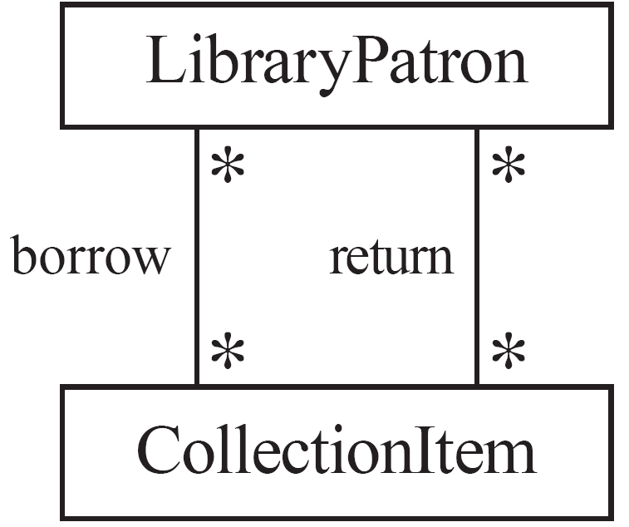
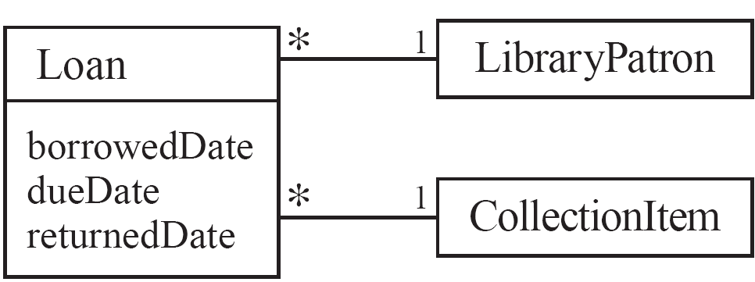
Actions versus associations
  A common mistake is to represent actions as if they were associations
Better: The
borrow
operation creates a
Loan
, and
Bad, due to the use of associations
the
return
operation sets the
returnedDate
that are actions
attribute.
Chapter 5: Modelling with classes

Slide 8
Identifying attributes
  Look for information that must be maintained about each class
  Several nouns rejected as classes, may now become attributes
  An attribute should generally contain a simple value
    E.g. string, number
Chapter 5: Modelling with classes

Slide 9
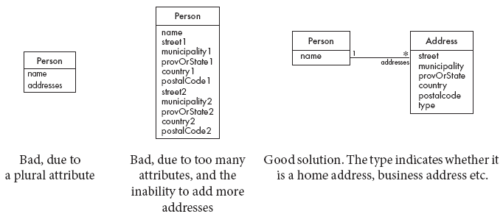
Tips about identifying and specifying valid attributes
  It is not good to have many duplicate attributes
  If a subset of a class’s attributes form a coherent group, then create a distinct class containing these attributes
Chapter 5: Modelling with classes

Slide 10
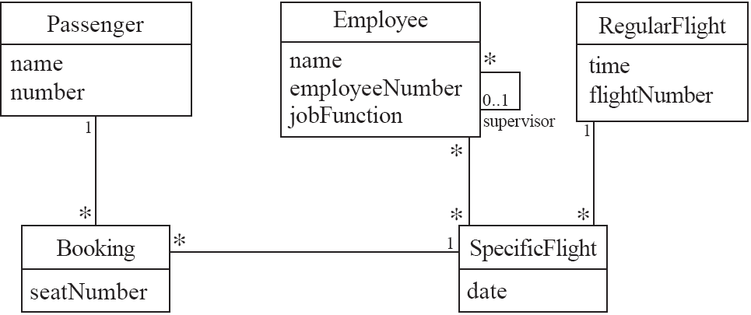
An example (attributes and associations)
Chapter 5: Modelling with classes

Slide 11
Identifying generalizations and interfaces
  There are two ways to identify generalizations:
    bottom-up
      Group together similar classes creating a new superclass
    top-down
      Look for more general classes first, specialize them if needed
  Create an interface, instead of a superclass if
    The classes are very dissimilar except for having a few operations in common
    One or more of the classes already have their own superclasses
    Different implementations of the same class might be available
Chapter 5: Modelling with classes

Slide 12
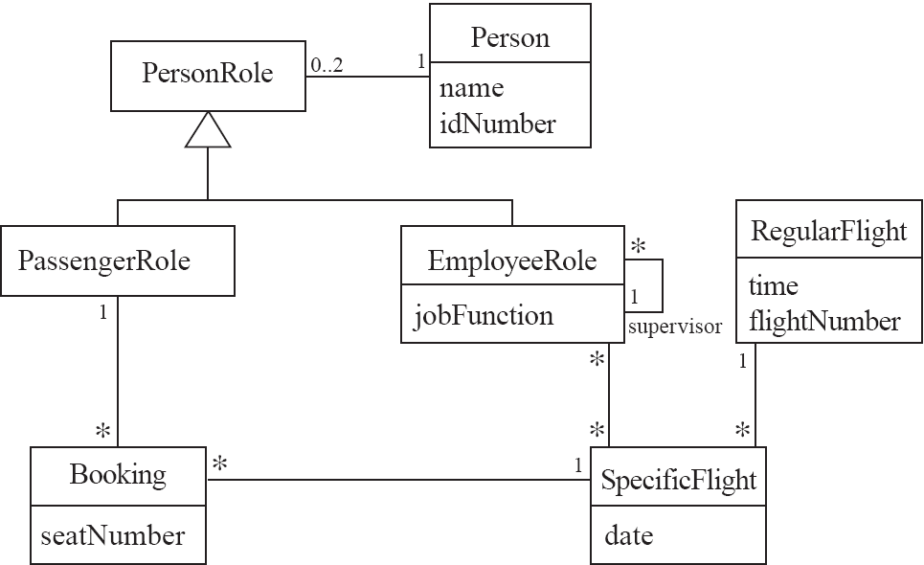
An example (generalization)
Chapter 5: Modelling with classes

Slide 13
Allocating responsibilities to classes
A responsibility is something that the system is required to do.
  Each functional requirement must be attributed to one of the classes
    All the responsibilities of a given class should be clearly related.
    If a class has too many responsibilities, consider splitting it into distinct classes
    If a class has no responsibilities attached to it, then it is probably useless
    When a responsibility cannot be attributed to any of the existing classes, then a new class should be created
  To determine responsibilities
    Perform use case analysis
    Look for verbs and nouns describing actions in the system description
Chapter 5: Modelling with classes

Slide 14
Categories of responsibilities
  Setting and getting the values of attributes
  Creating and initializing new instances
  Loading to and saving from persistent storage
  Destroying instances
  Adding and deleting links of associations
  Copying, converting, transforming, transmitting or outputting
  Computing numerical results
  Navigating and searching
  Other specialized work
Chapter 5: Modelling with classes

Slide 15
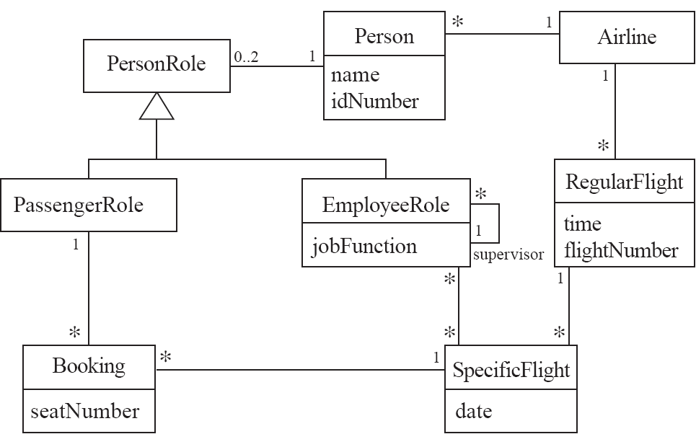
An example (responsibilities)
Creating a new regular flight
Searching for a flight
Modifying attributes of a flight
Creating a specific flight
Booking a passenger
Canceling a booking
Chapter 5: Modelling with classes

Slide 16
Prototyping a class diagram on paper
  As you identify classes, you write their names on small cards
  As you identify attributes and responsibilities, you list them on the cards
    If you cannot fit all the responsibilities on one card:
      this suggests you should split the class into two related classes.
  Move the cards around on a whiteboard to arrange them into a class diagram.
  Draw lines among the cards to represent associations and generalizations.
Chapter 5: Modelling with classes

Slide 17
Identifying operations
Operations are needed to realize the responsibilities of each class
  There may be several operations per responsibility
  The main operations that implement a responsibility are normally declared public
  Other methods that collaborate to perform the responsibility must be as private as possible
Chapter 5: Modelling with classes

Slide 18
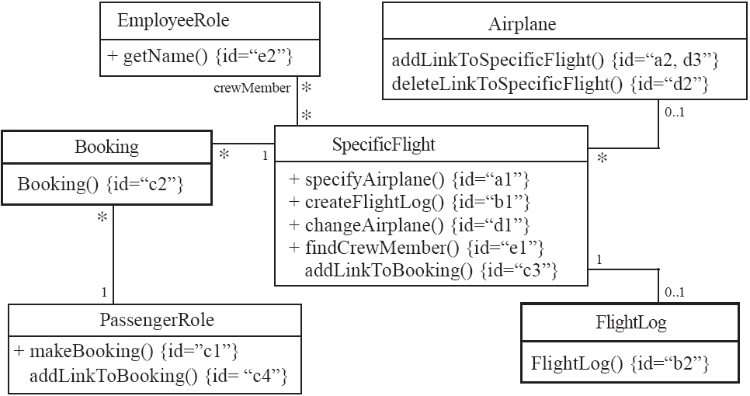
An example (class collaboration)
Chapter 5: Modelling with classes

Slide 19
5.10 Implementing Class Diagrams in Java
  Attributes are implemented as instance variables
  Generalizations are implemented using extends
  Interfaces are implemented using implements
  Associations are normally implemented using instance variables
Chapter 5: Modelling with classes

Slide 20
For Further reading
Book: object-oriented-software-engineering-practical-software-development-using-uml-and-java
Chapter 5
  Section 5.9: The process of developing class diagrams
Chapter 5: Modelling with classes

